Slide 1


Objects Detection from images
Introduction about the project (5minutes)
Purpose
Techniques is using
Contributions
Asmina (5 minutes)
Show different ways to detect objects in images, what are advantages, disadvantages, etc.
Why should use YOLO?
Duy (5 minutes)
Introduce YOLO models, YOLO versions,…
Show YOLO models deeply and the way to apply it into project
Demo
Use pre-trained YOLOv8 to predict the objects in an image and video
Knowledge transfering: Train YOLOv8 model on customized dataset and predict
Notes:
The project aims to develop a robust object recognition system capable of identifying and classifying objects within images using machine learning techniques. The core objective is to leverage advanced image processing algorithms and deep learning models to accurately detect and label various objects, such as vehicles, animals, or everyday items, in diverse image datasets. This system will be designed to handle a wide range of object types and conditions, providing a scalable solution for applications in automated surveillance, image tagging, and real-time object tracking.
To achieve this, the project will involve training convolutional neural networks (CNNs) on large-scale image datasets. The system will be evaluated based on its precision, recall, and overall accuracy in object classification. Additionally, performance metrics will be analyzed to ensure the model’s effectiveness across different environments and object categories. The project will also explore techniques to optimize the model’s performance and address challenges such as occlusion, varying lighting conditions, and object size variations.

Slide 2
Introduction to Object Detection
Definition: Object detection is a computer vision technique that involves identifying and locating objects within an image or video.
Importance: Essential for various applications like autonomous driving, surveillance, medical imaging, etc.
Overview: How object detection has evolved from traditional methods to modern deep learning techniques

Slide 3
Purpose Of Object Detection
Objective: To enable machines to perceive and understand visual content similarly to humans.
Applications: Used in industries such as automotive (self-driving cars), healthcare (diagnostics), security (surveillance), and more.
Future Prospects: Enhancing automation, improving safety, and revolutionizing technology through advanced visual recognition systems

Slide 4
Techniques in Object Detection
Traditional Method
Sliding Window: A brute-force method to search the entire image for objects.
Feature-Based Methods: Using features like SIFT, HOG to detect objects.
Advantages/Disadvantages: Traditional methods are less accurate and computationally expensive.
Modern Methods
Convolutional Neural Networks (CNNs): Backbone of modern object detection techniques.
Region-Based CNN (R-CNN): Proposes regions of interest before classification.
You Only Look Once (YOLO): A single network predicts bounding boxes and class probabilities directly from the full image.
Advantages/Disadvantages: Modern methods are more accurate and faster but require more computational power.

Slide 5
Contribution to the Field
Research Developments: Evolution from R-CNN to YOLO, Faster R-CNN, and SSD (Single Shot Multibox Detector).
Research Developments: Evolution from R-CNN to YOLO, Faster R-CNN, and SSD (Single Shot Multibox Detector).
Your Contribution (if applicable): Any specific contribution you've made to the project or research.

Slide 6

Why YOLO?
Introduction to YOLO
Full Form: You Only Look Once.
How It Works: YOLO divides the image into a grid and predicts bounding boxes and probabilities for each grid cell in a single forward pass.
Advantages:
Speed: YOLO is extremely fast due to its single-pass approach.
Real-time Detection: Suitable for real-time applications.
Accuracy: YOLO achieves high accuracy with fewer false positives compared to other techniques.
Disadvantages:
Localization Error: YOLO may struggle with small objects due to its grid-based approach.
Complexity in Training: Requires a large amount of labeled data for training.

Slide 7
Comparison of Object Detection Techniques
R-CNN vs YOLO:
R-CNN: Accurate but slower due to multiple passes.
YOLO: Faster, ideal for real-time detection, but slightly less accurate on smaller objects.
Other Techniques
SSD (Single Shot Multibox Detector): A balance between YOLO and R-CNN in terms of speed and accuracy.
Faster R-CNN: Improved speed over R-CNN but still not as fast as YOLO.
Visual Examples: Show a few images comparing detection outputs using different techniques
Notes:
There are several approaches to object detection, each with unique advantages and limitations. We will compare traditional techniques with modern approaches and delve into the specifics of the YOLO method."
Traditional Techniques:
Sliding Window: A brute-force method that scans the entire image using a fixed-size window to search for objects. While simple, it is computationally expensive and often slow, as it requires checking multiple regions of the image.
Feature-Based Methods: Techniques like SIFT (Scale-Invariant Feature Transform) and HOG (Histogram of Oriented Gradients) are used to detect objects by extracting distinctive features from images. These methods work well for specific tasks but can struggle with complex scenes and variations in object appearance.
Convolutional Neural Networks (CNNs): The backbone of modern object detection, CNNs automatically learn hierarchical features from data, providing high accuracy in detecting and classifying objects.
Region-Based CNN (R-CNN): This approach first proposes regions of interest (ROIs) in the image and then classifies these regions using CNNs. While accurate, it can be slow due to the multiple stages involved.
You Only Look Once (YOLO): YOLO is a breakthrough in object detection, where a single network predicts bounding boxes and class probabilities directly from the entire image. It’s designed for speed, making it one of the fastest object detection methods available
Traditional methods like Sliding Window and Feature-Based Methods are straightforward but often inefficient and less effective in complex scenarios."
"Modern methods, particularly those based on CNNs, provide higher accuracy and are more adaptable to variations in objects and scenes."
"YOLO stands out by combining speed and accuracy, making it ideal for real-time applications where quick detection is crucial.

Slide 8
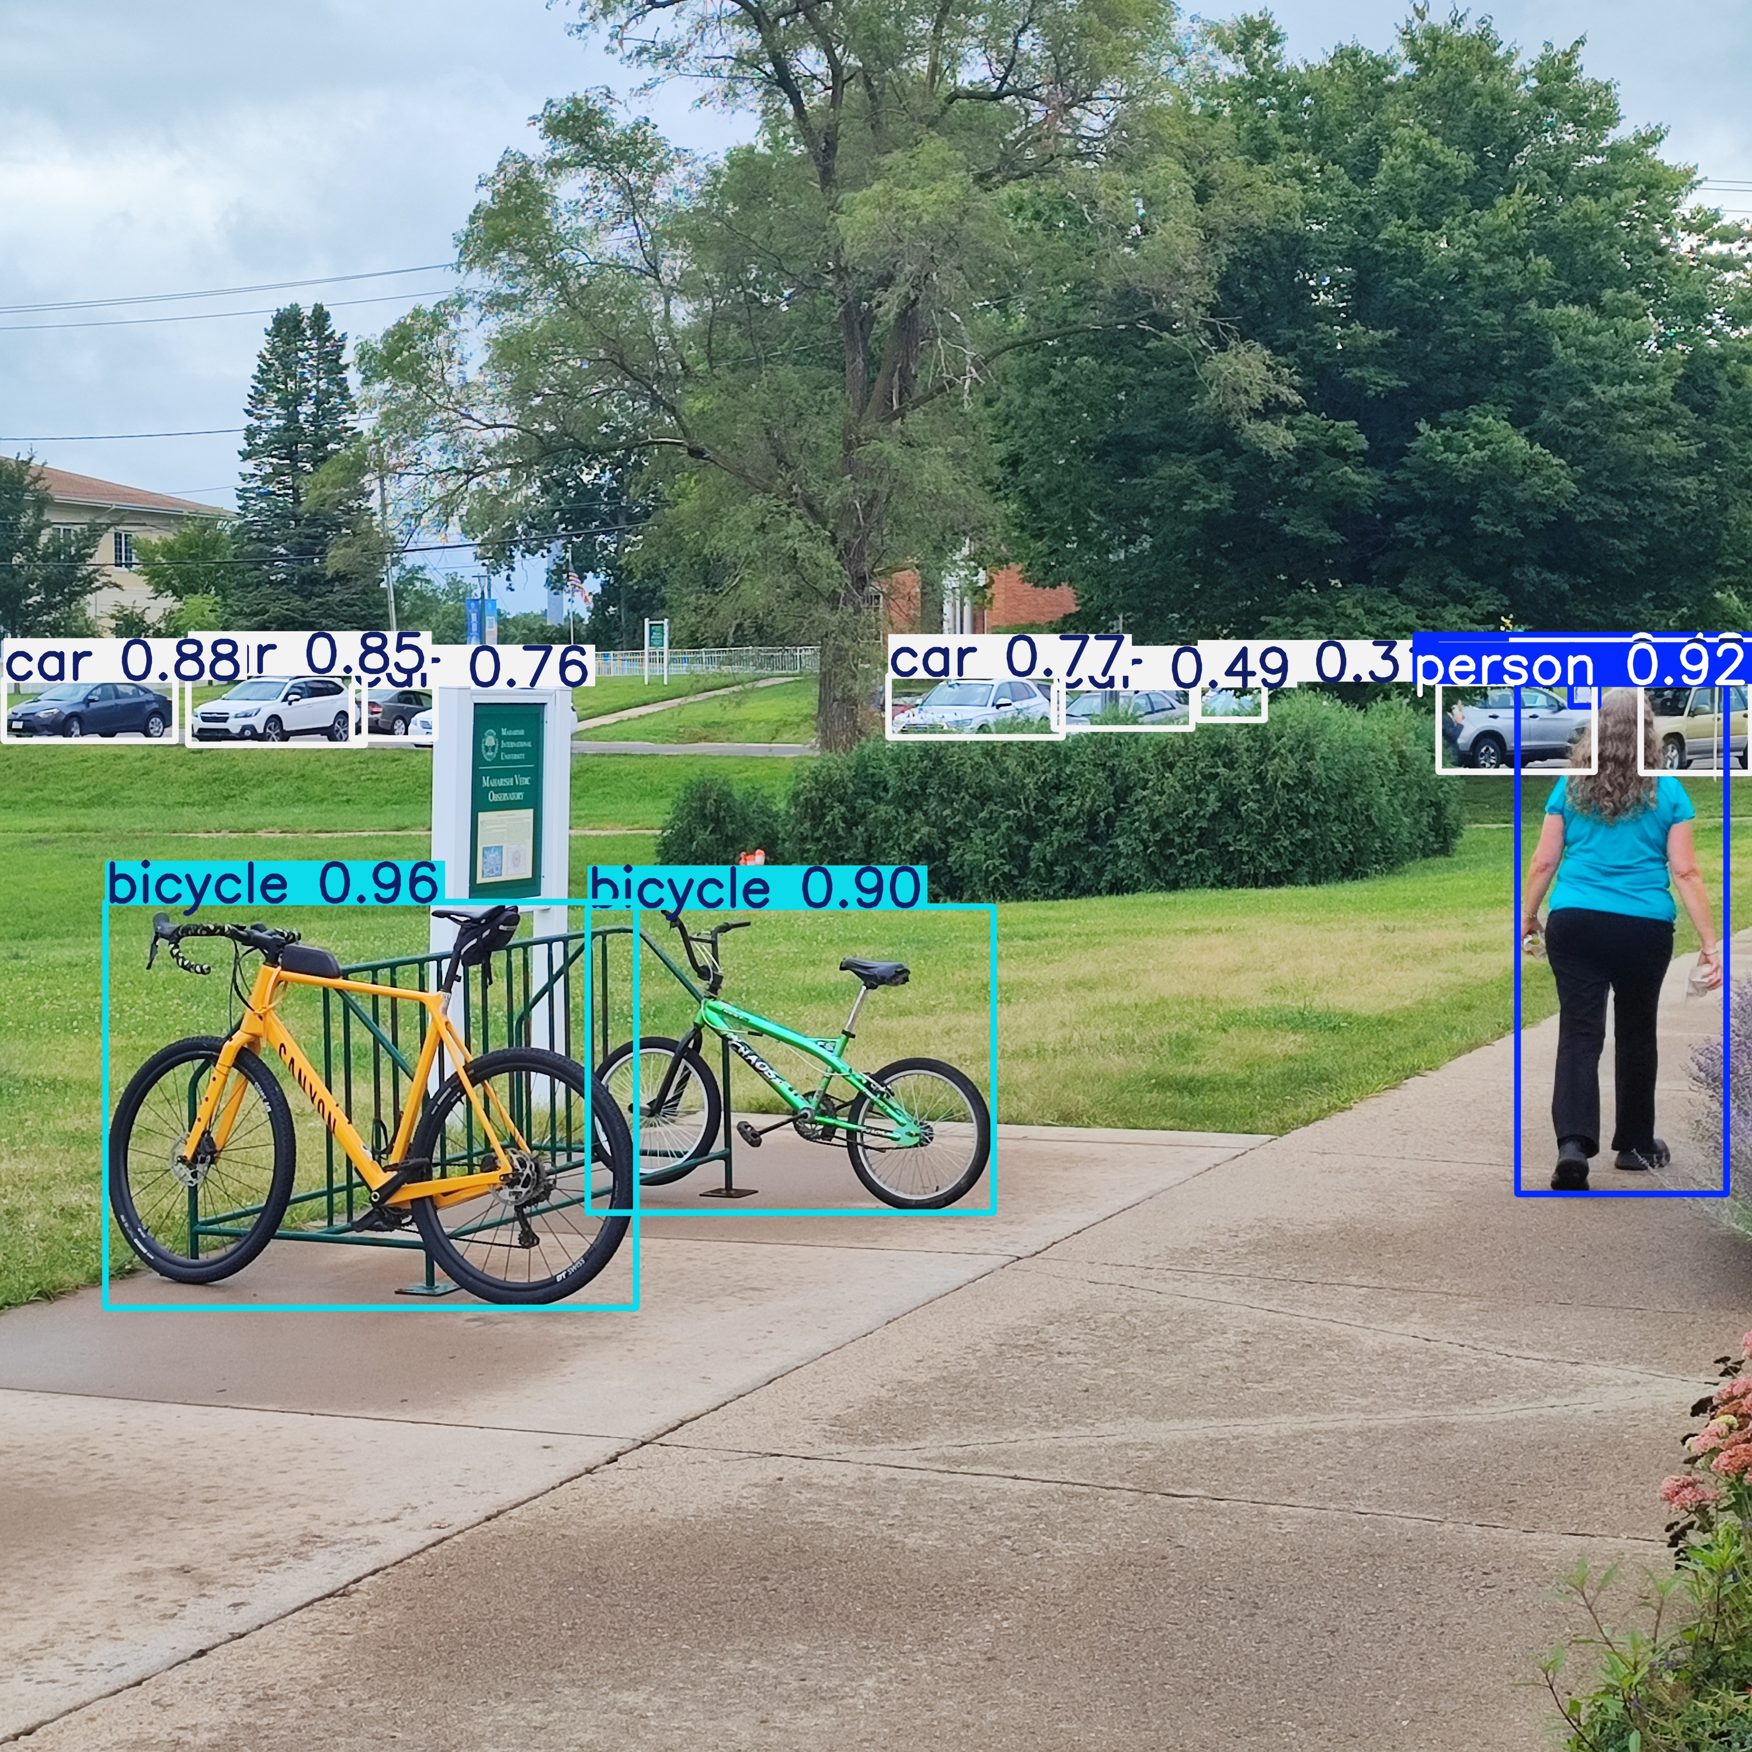
Demo
Part 1 - Detect objects in unseen image using pre-trained YOLOv8 model

Slide 9
Introduction to YOLOv8
YOLOv8 is from the YOLO family of models and was released on January 10, 2023
YOLOv8 is the latest iteration in the YOLO series of real-time object detectors, offering cutting-edge performance in terms of accuracy and speed.
Building upon the advancements of previous YOLO versions, YOLOv8 introduces new features and optimizations that make it an ideal choice for various object detection tasks in a wide range of applications.

Slide 10
Key Features of YOLOv8
Advanced Backbone and Neck Architectures: YOLOv8 employs state-of-the-art backbone and neck architectures, resulting in improved feature extraction and object detection performance.
Anchor-free Split Ultralytics Head: YOLOv8 adopts an anchor-free split Ultralytics head, which contributes to better accuracy and a more efficient detection process compared to anchor-based approaches.
Optimized Accuracy-Speed Tradeoff: With a focus on maintaining an optimal balance between accuracy and speed, YOLOv8 is suitable for real-time object detection tasks in diverse application areas.
Variety of Pre-trained Models: YOLOv8 offers a range of pre-trained models to cater to various tasks and performance requirements, making it easier to find the right model for your specific use case.

Slide 11
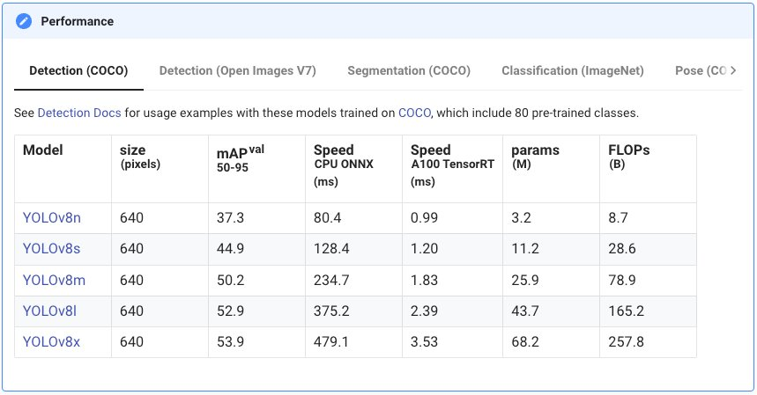
YOLOv8 Performance

Slide 12
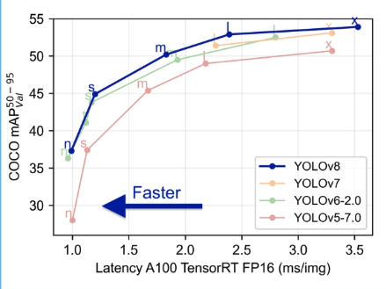
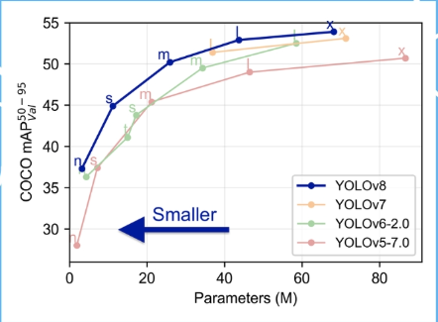
Enhancements Over Previous Versions

Slide 13
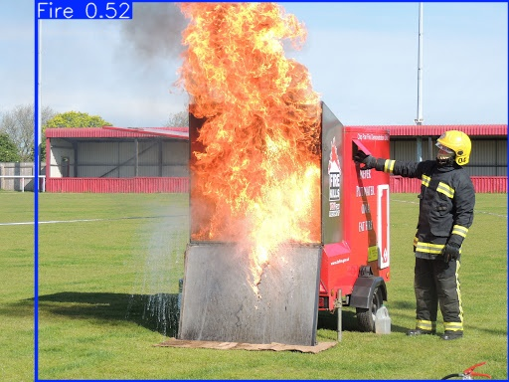
Demo
Part 2 - Knowledge transfering - Re-train YOLOv8 model on custom specific data as Fire dataset

